Slide 1
Introducing the
Early Primary
Reading Assessment (EPRA)
Common Text
K - 2
©Faye Brownlie
co-created with Jean Adshead & Gina Rae

Slide 2
The Early Primary Common Text Reading Assessment
Purpose:
• used for assessing “reading for information” to inform instruction
• used as bookends for assessing:
- Fall assessment “for” learning
- Spring assessment “of” learning

Slide 3
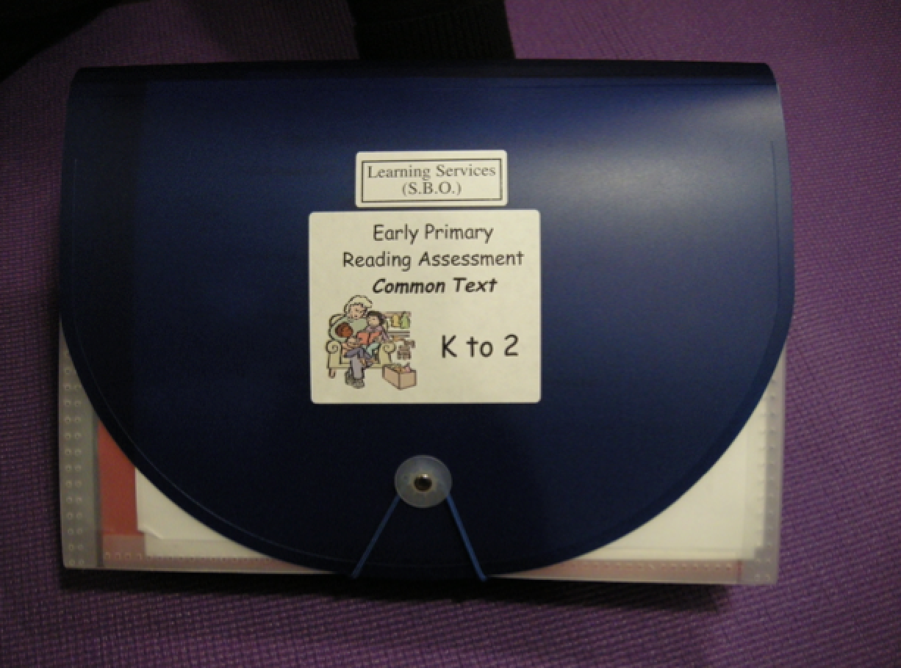

Slide 4
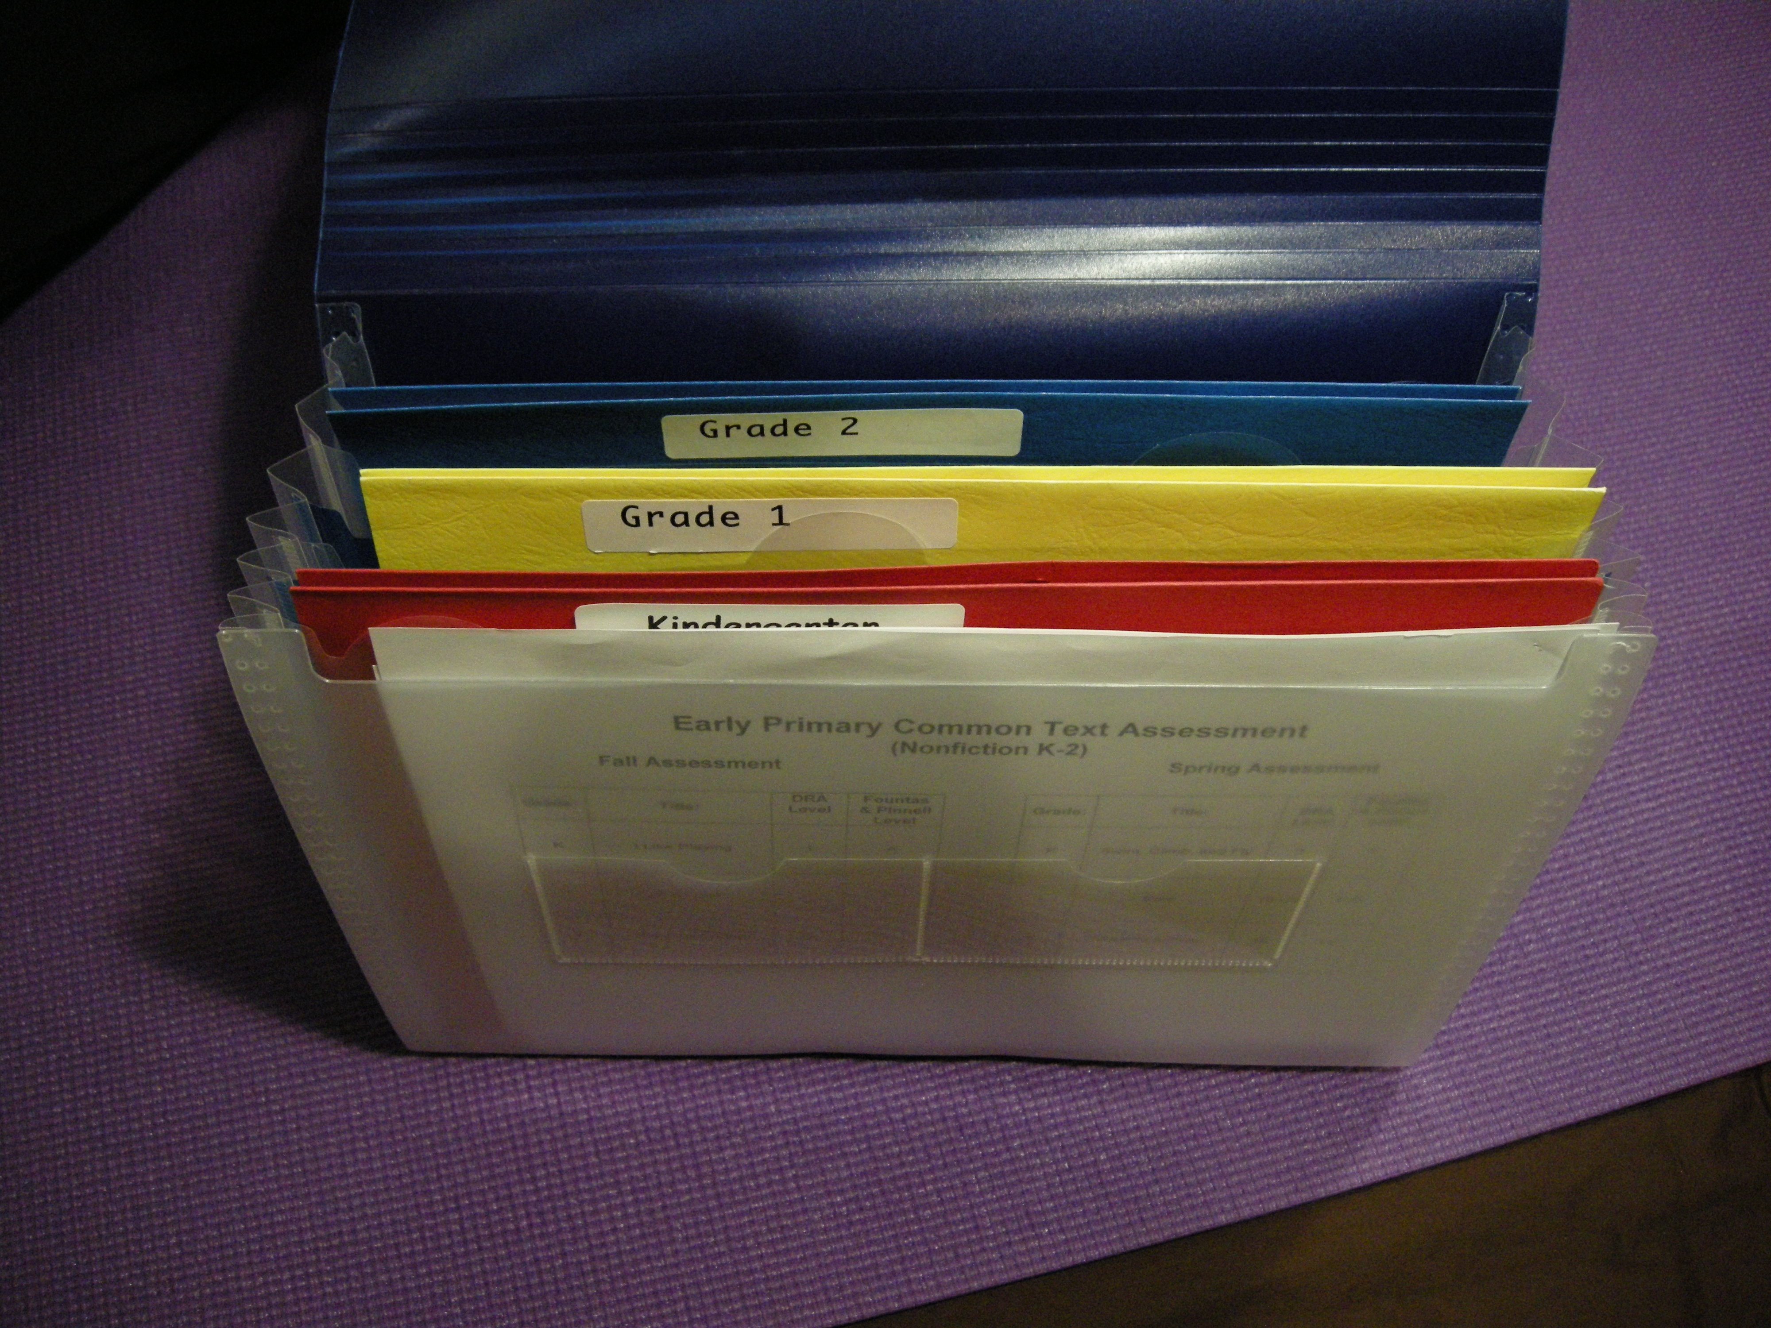

Slide 5
Each kit includes:
Teacher protocols
Question and answer sheets:
• students can show through drawing, writing and dialogue information about what they have read
Oral reading sheets:
• teachers do a running record and notice student’s concepts of print
Conference sheets:
• teachers conference individually with students to go deeper into their understanding

Slide 6
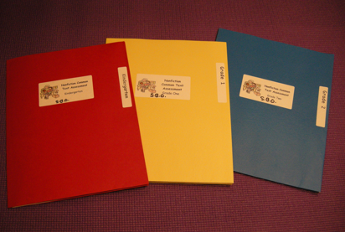

Slide 7
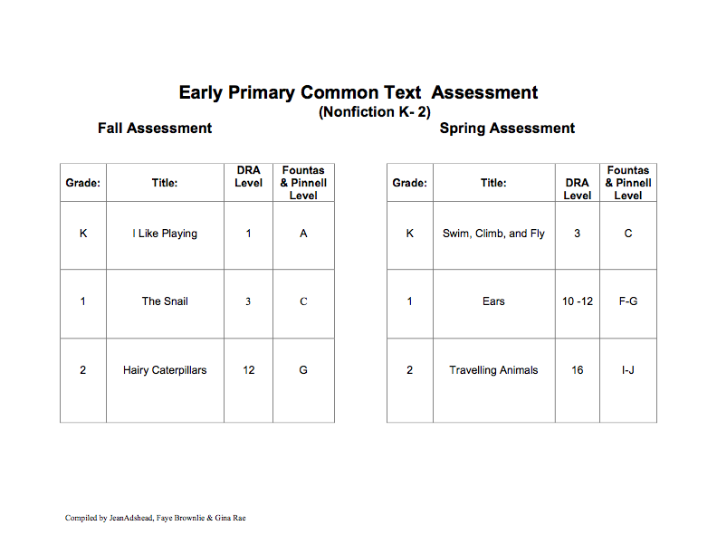

Slide 8
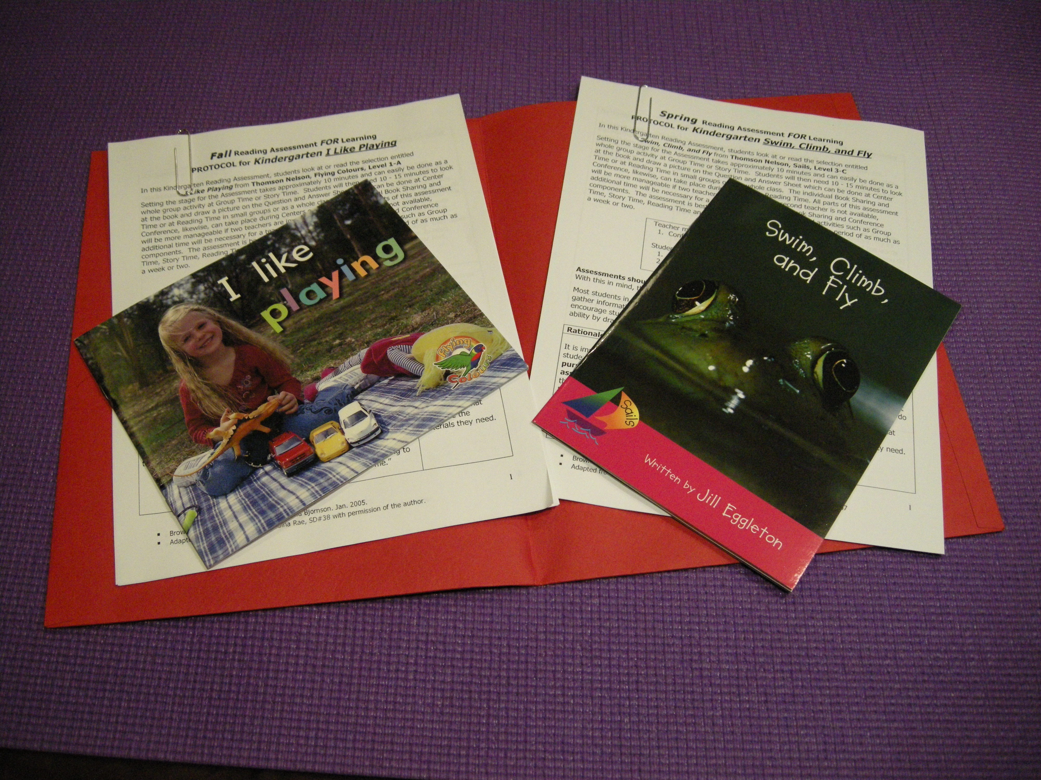

Slide 9
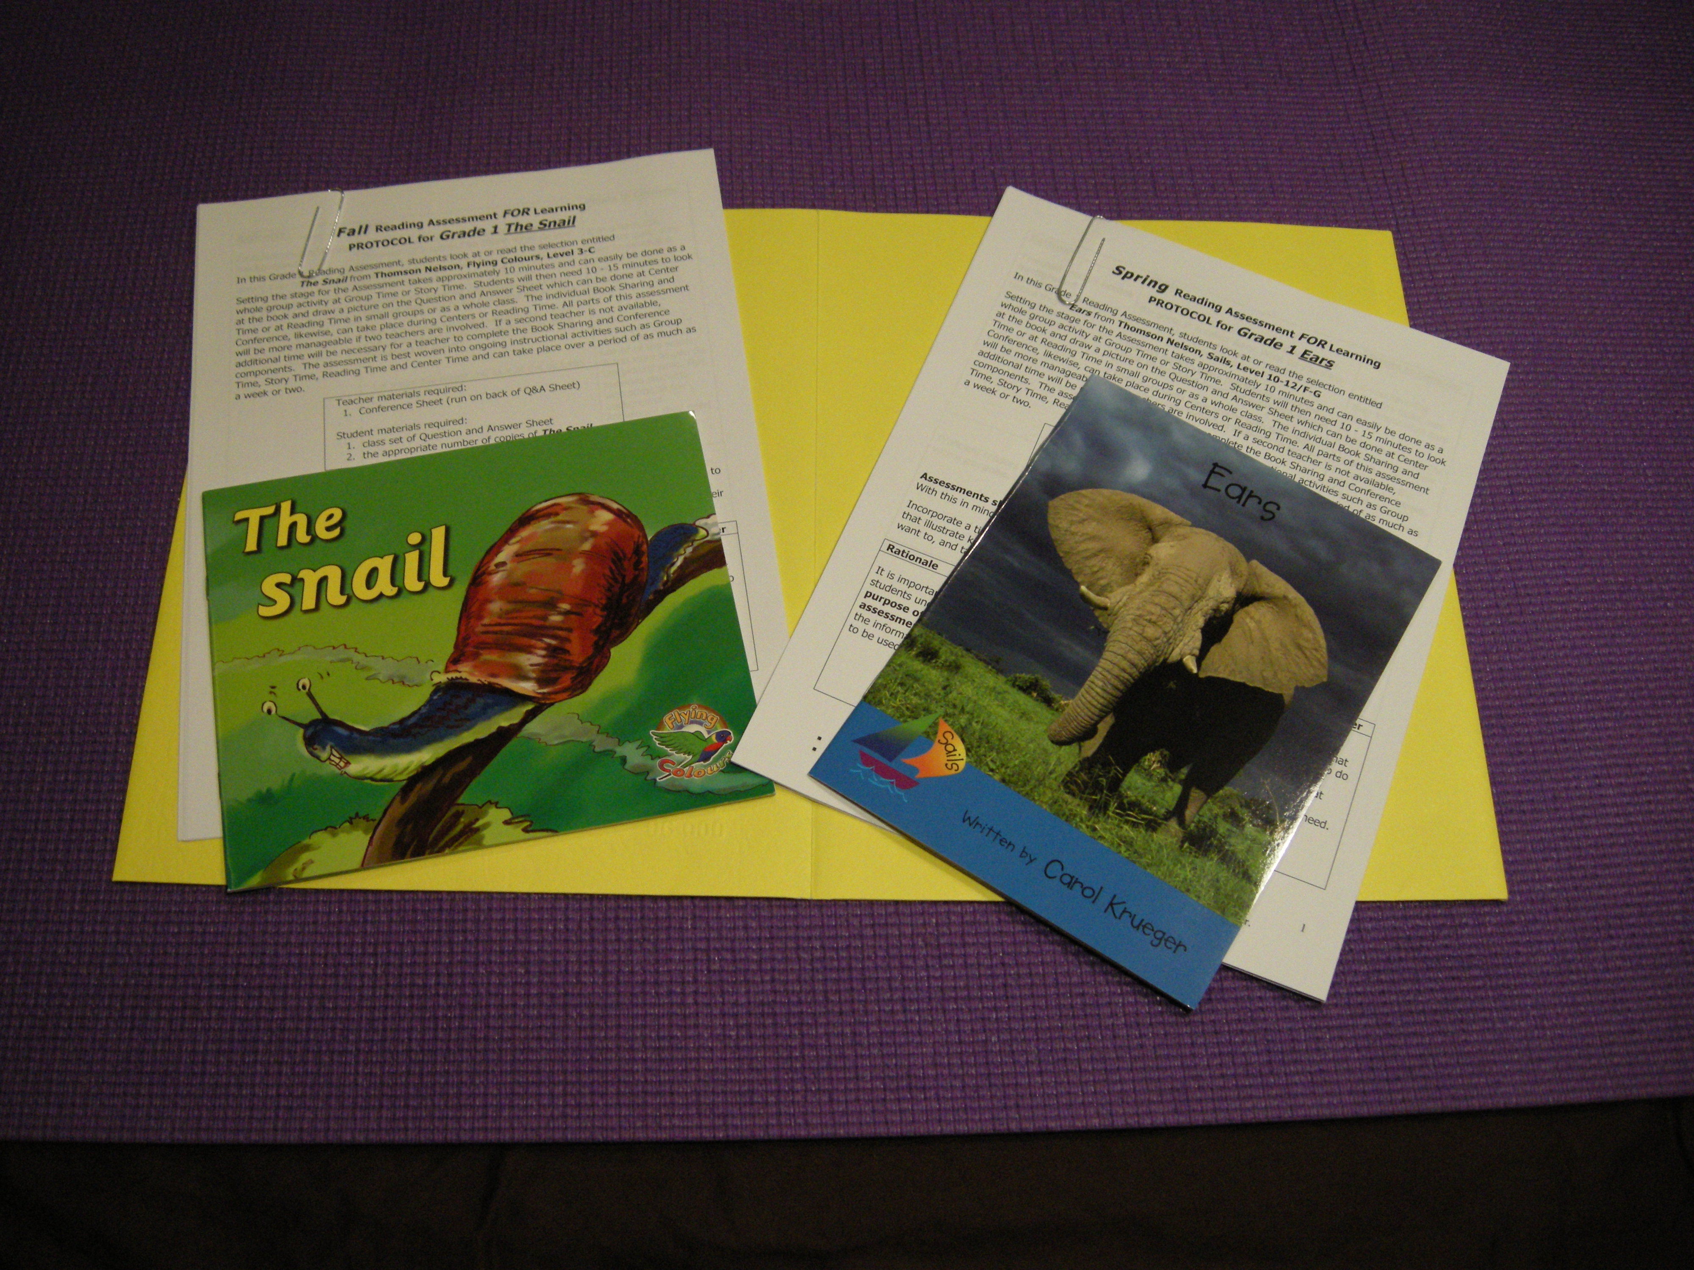

Slide 10
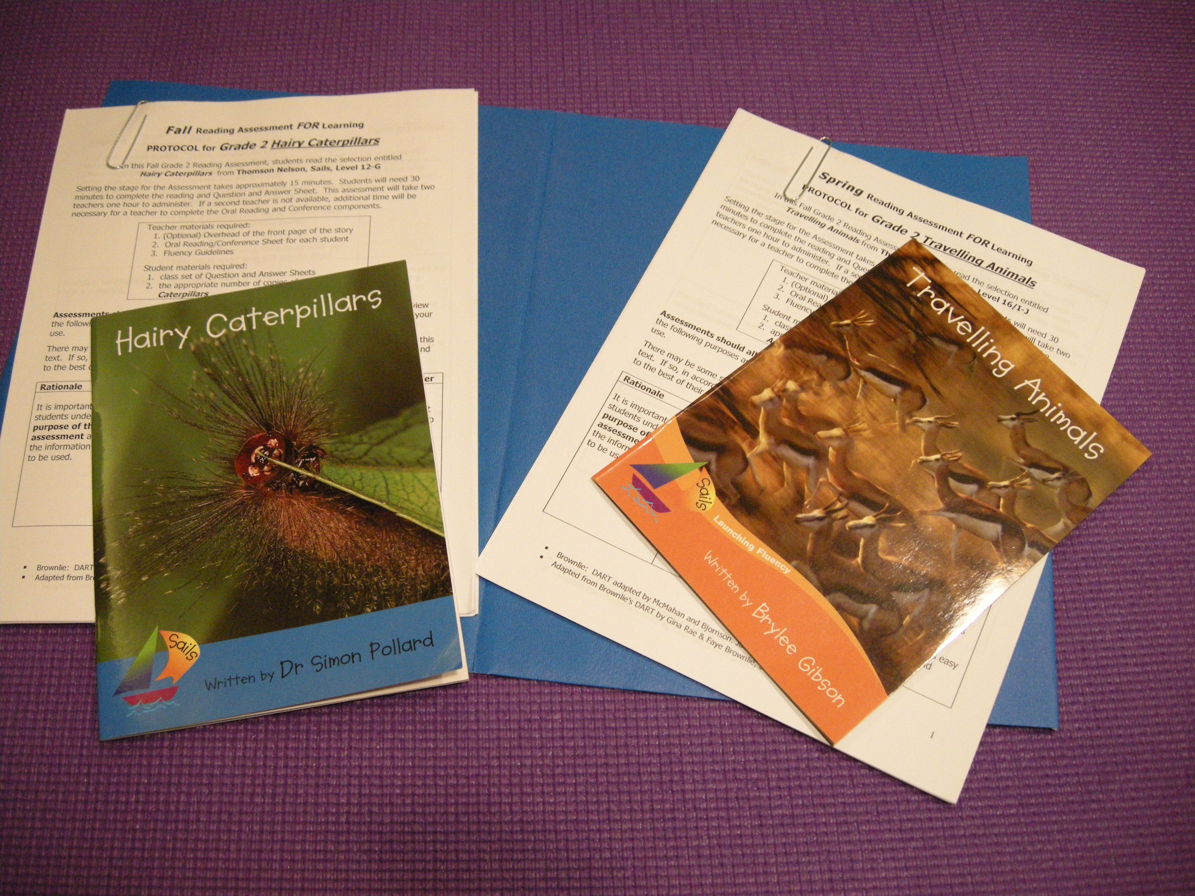

Slide 11
After assessment scoring materials:
• Kindergarten reading profile
• Performance Standards for Grade 1 & Grade 2
• worksheets for each grade level to plan your next steps for instruction

