Slide 1
The Early Primary
Reading Assessment (EPRA)
Leveled Text
K to 2
©Faye Brownlie
co-created with Jean Adshead & Gina Rae

Slide 2
The Early Primary Leveled Text Assessment
Purpose:
• used for assessing “reading for information” to inform instruction
• used as on-going assessment - in-between Fall & Spring

Slide 4
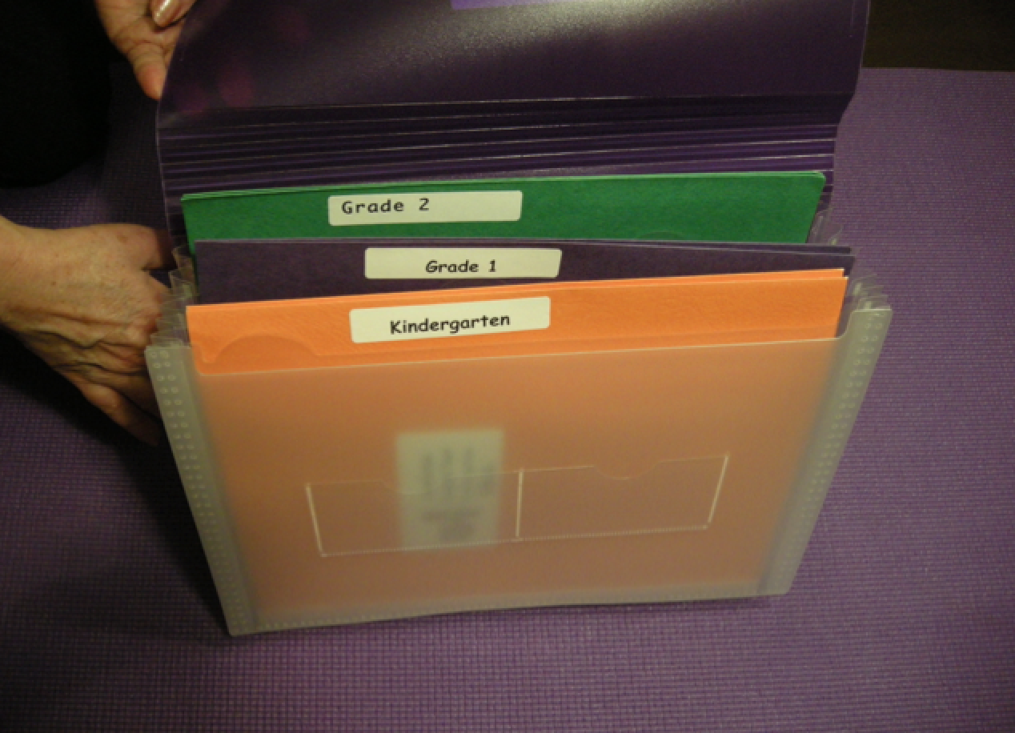

Slide 5
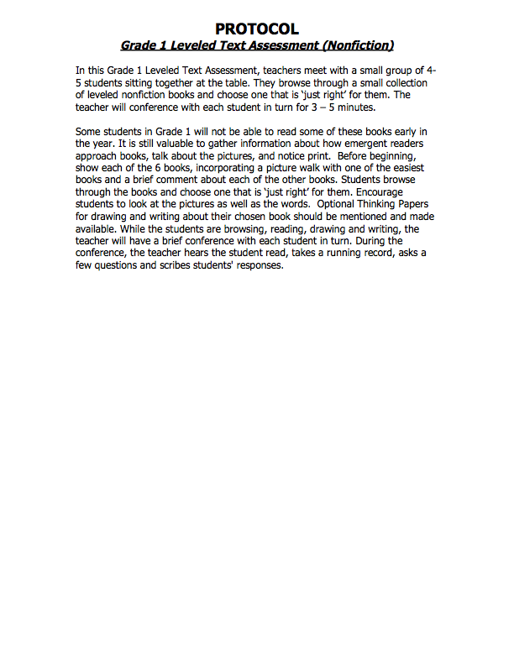
The Leveled Text kit includes clearly written protocols:

Slide 6
Each kit includes:
Teacher Protocols
Oral reading sheets:
• teachers use these to do a running record and notice students’ understanding of the concepts of print
Conference sheets:
• teachers conference individually with students to go deeper into their comprehension
Optional Thinking Papers:
• students can show through drawing, writing and
dialogue information about what they have read

Slide 7
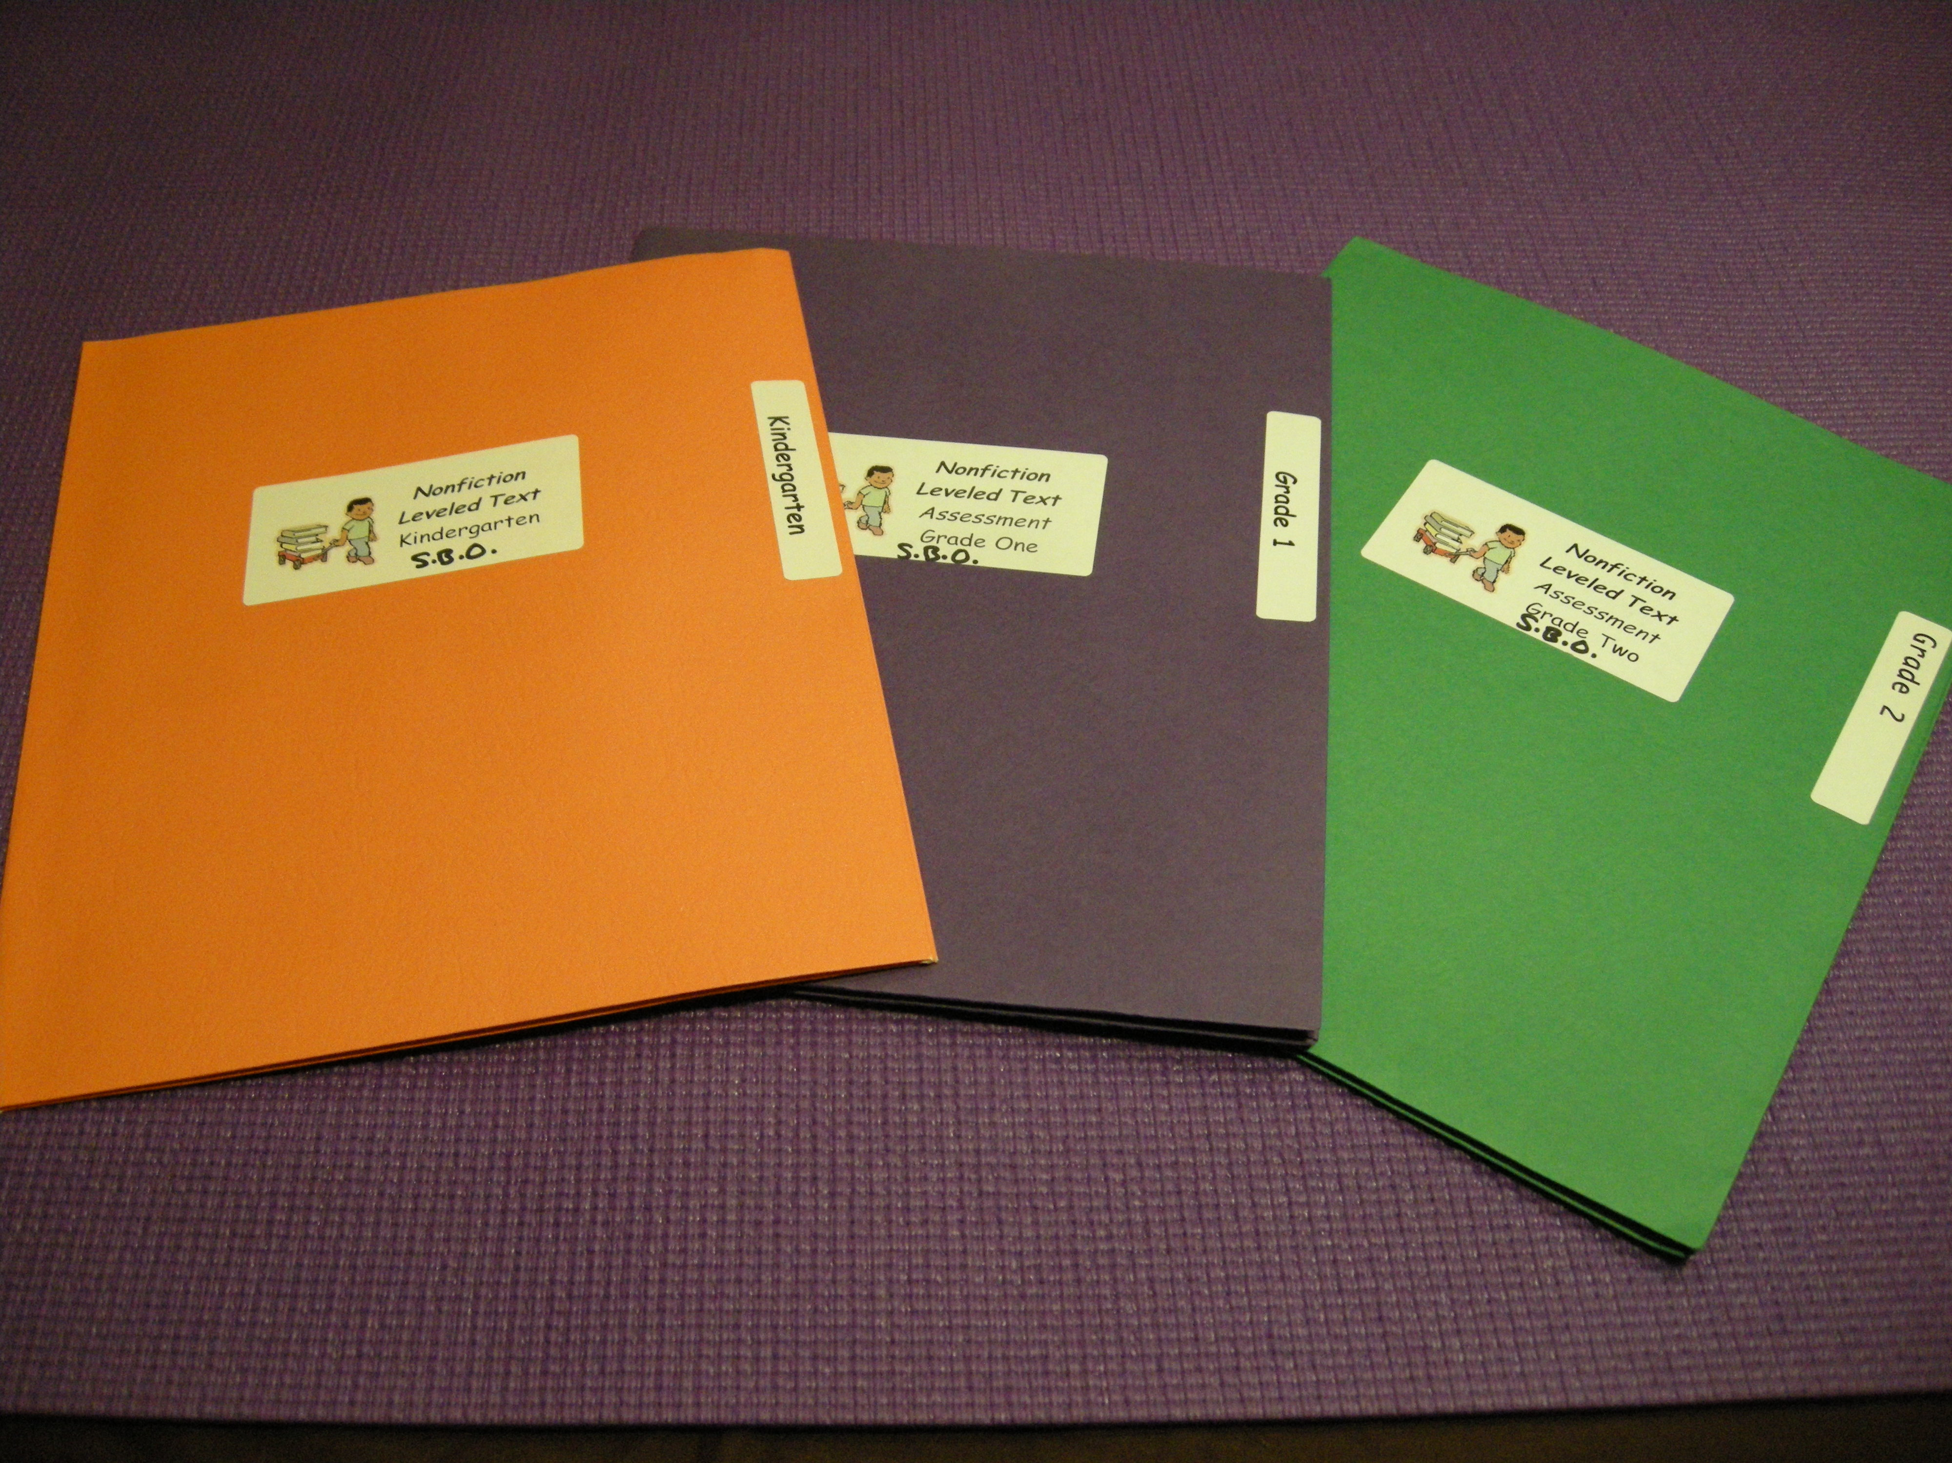

Slide 8
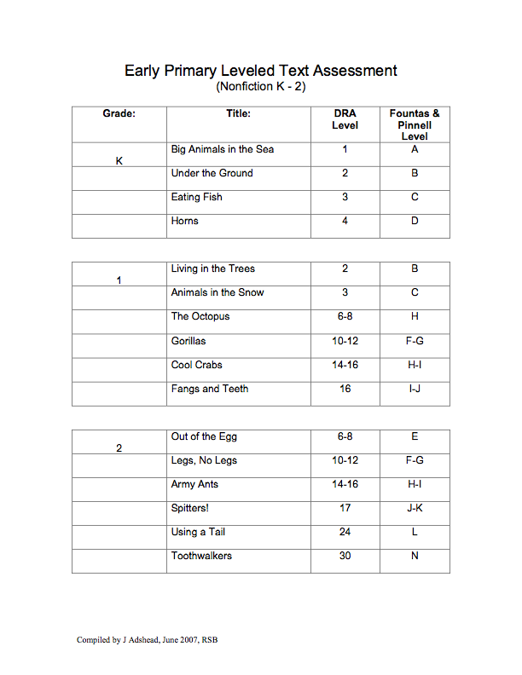

Slide 11
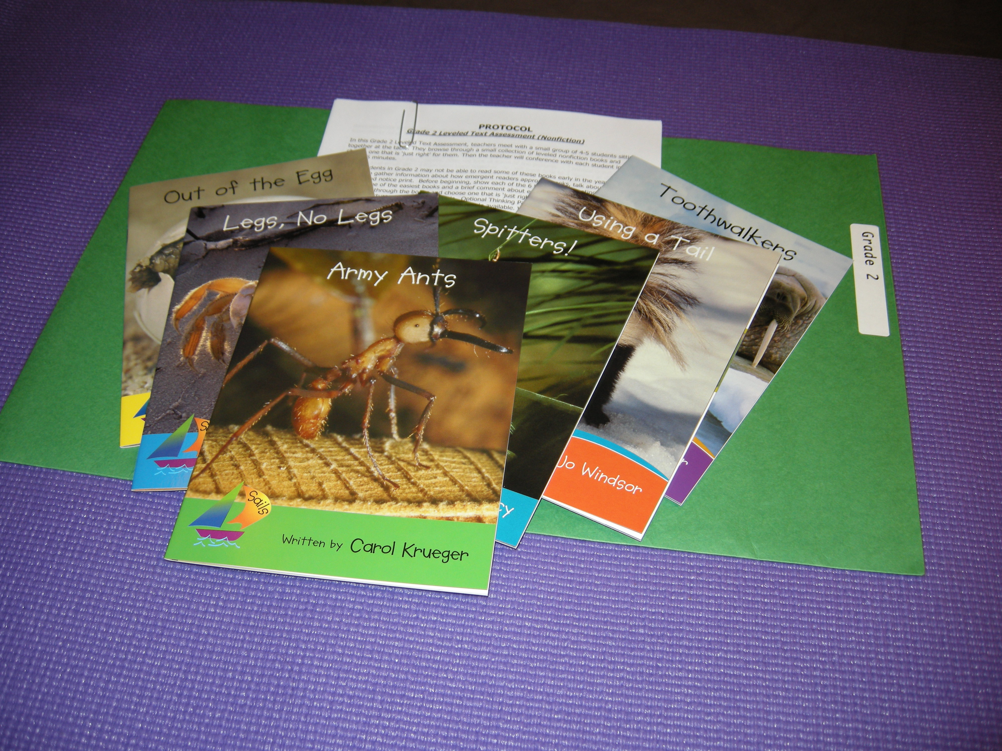

Slide 12
After assessment scoring materials:
• Kindergarten reading profile
• Performance Standards for Grade 1 & Grade 2
• worksheets for each grade level to plan your next steps for instruction

